Slide 1
MACHINE LEARNING
HYPERPARAMERTER TUNING

Slide 2
Hyperparameter tuning:
Hyperparameter Tuning is the process of determining the right combination of hyperparameters that allows the model to increase model performance and prediction. By using tuning we can enhance the accuracy of model.
Setting the correct combination of hyperparameters is the only way to extract the maximum performance out of models.
To increase the model performance and to overcome this we use hyperparameter.

Slide 3
Techniques of Hyperparameter Tuning
Grid Search
Random search

Slide 4
Grid Search:
In Grid Search, we try every combination of a preset list of values of the hyper-parameters and evaluate the model for each combination.
Basically, we try every combination of set of values of the hyper parameter and evaluate the model for each combination.
Once all the combinations are evaluated, the model with the set of parameters which give the top accuracy is considered to be the best.
The name “grid” comes to the fact that all possible candidates within all needed hyperparameters are combined in a sort of grid. The combination yielding the best performance, preferably evaluated in a validation set, is then selected.

Slide 5
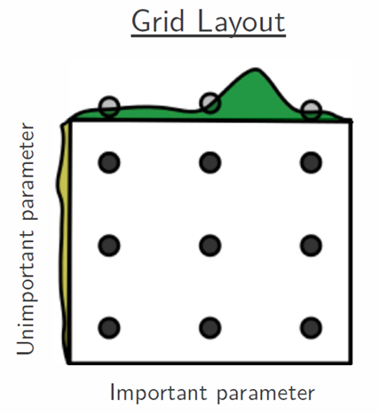

Slide 6
Disadvantages Grid Search:
It is very slow.
Checking every combination of the space requires a lot of time.
In every point in the grid needs k-fold cross-validation, which requires k training steps. So, tuning the hyperparameters of a model in
this way can be quite complex and expensive.
If we pass multiple parameter then size of grid will increase, iteration will increase and it will be very time consuming process

Slide 7
Random Search:
Random search is a technique where random combinations of the hyperparameters are used to find the best solution for the built model.
Instead of checking for each and every combination it selects some random combination or hyperparameters and check for those values.
It can also use for multiple hyperparameter at a time randomly and gives best accuracy. Model gives good result.

Slide 8
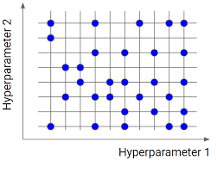

Slide 9
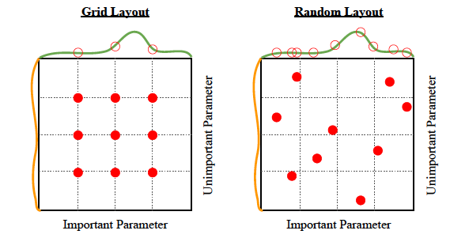
Difference between Grid and Random layout

